Slide 1
2023 MRDT Nav Board V2
By Thomas Francois

Slide 2

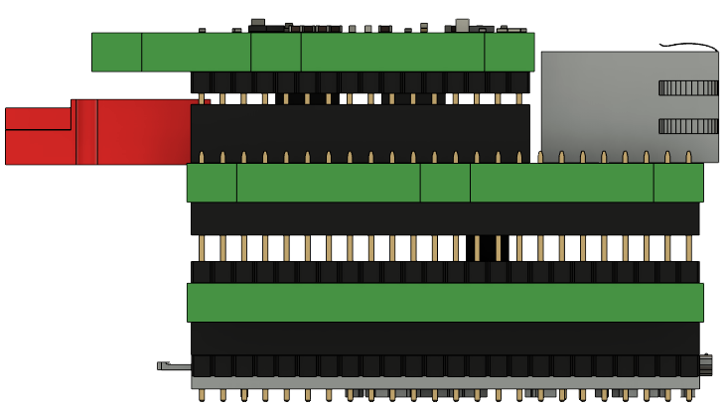
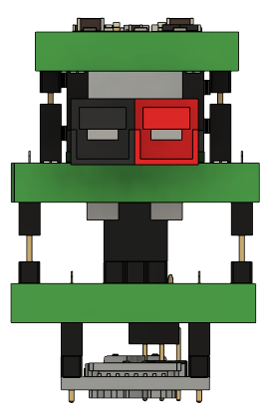
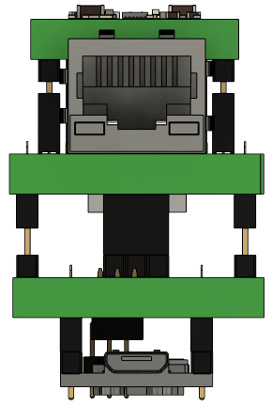
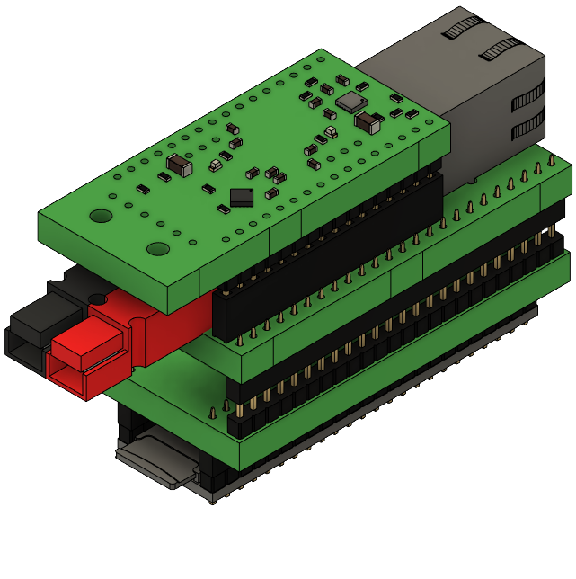
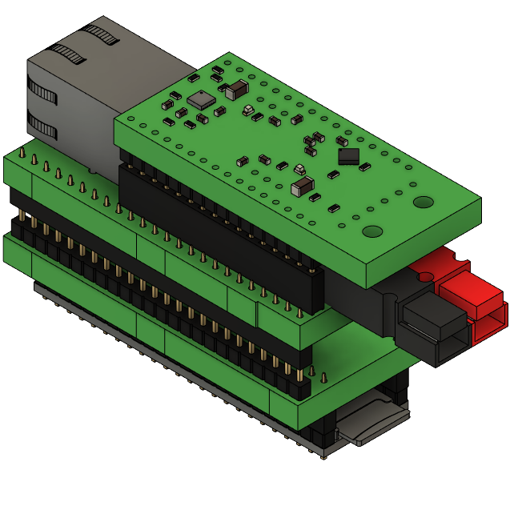
3D Renderings

Slide 3

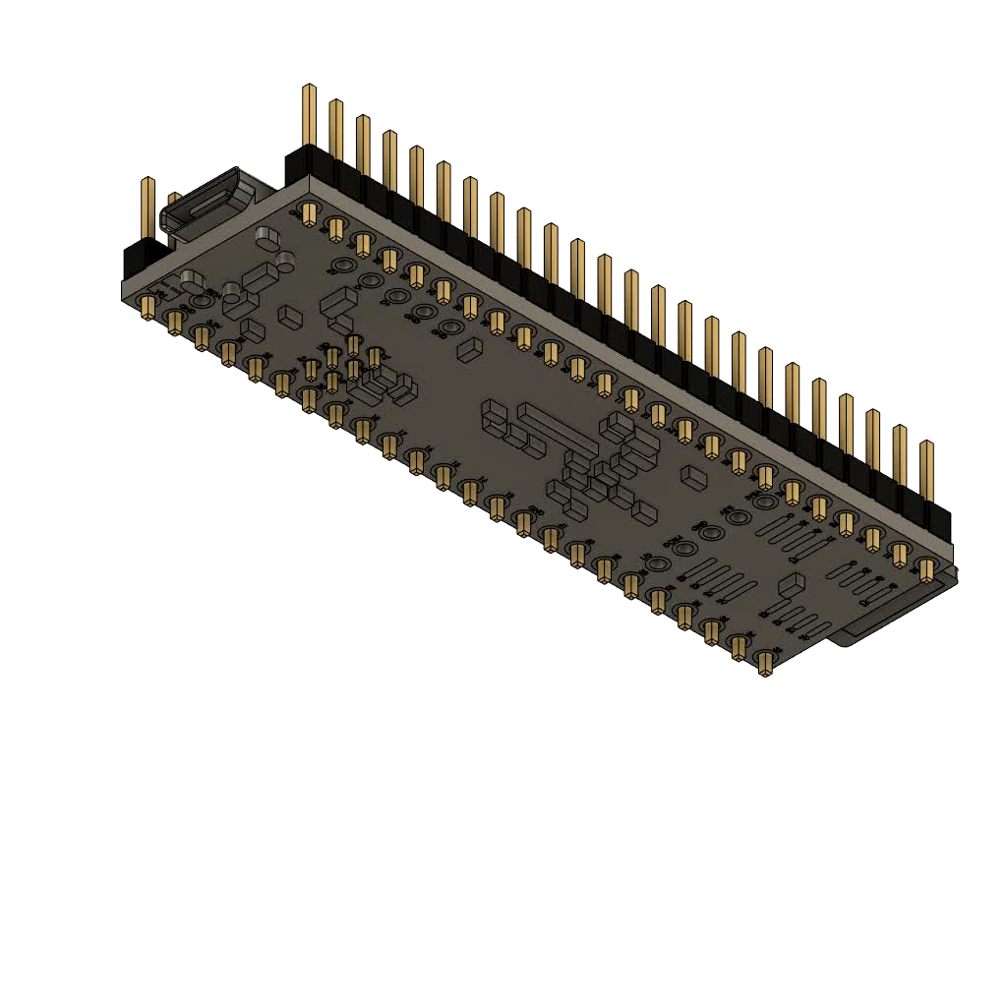
3D Animation

Slide 4
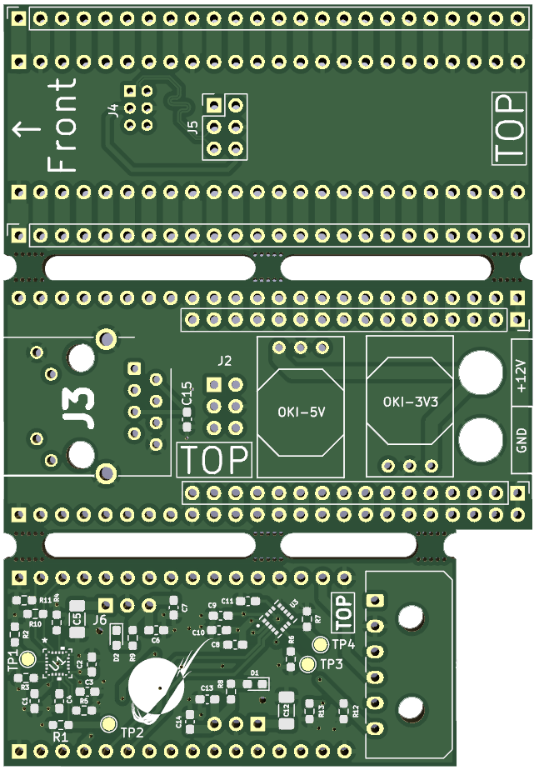
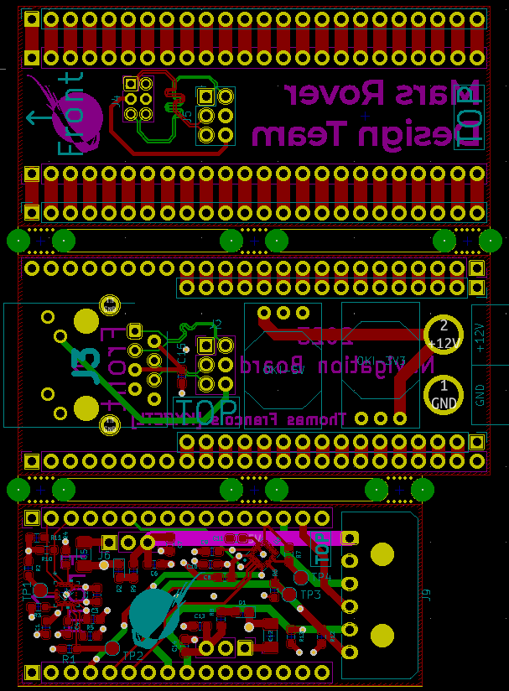
PCB Structure
3 Modules:
Teensy Adapter
Main Board
Top Board
Boards Joined By Mouse Bites
Perforations allow separation
4 – Layers
Entire Assembly: 62mm x 90mm

Slide 5
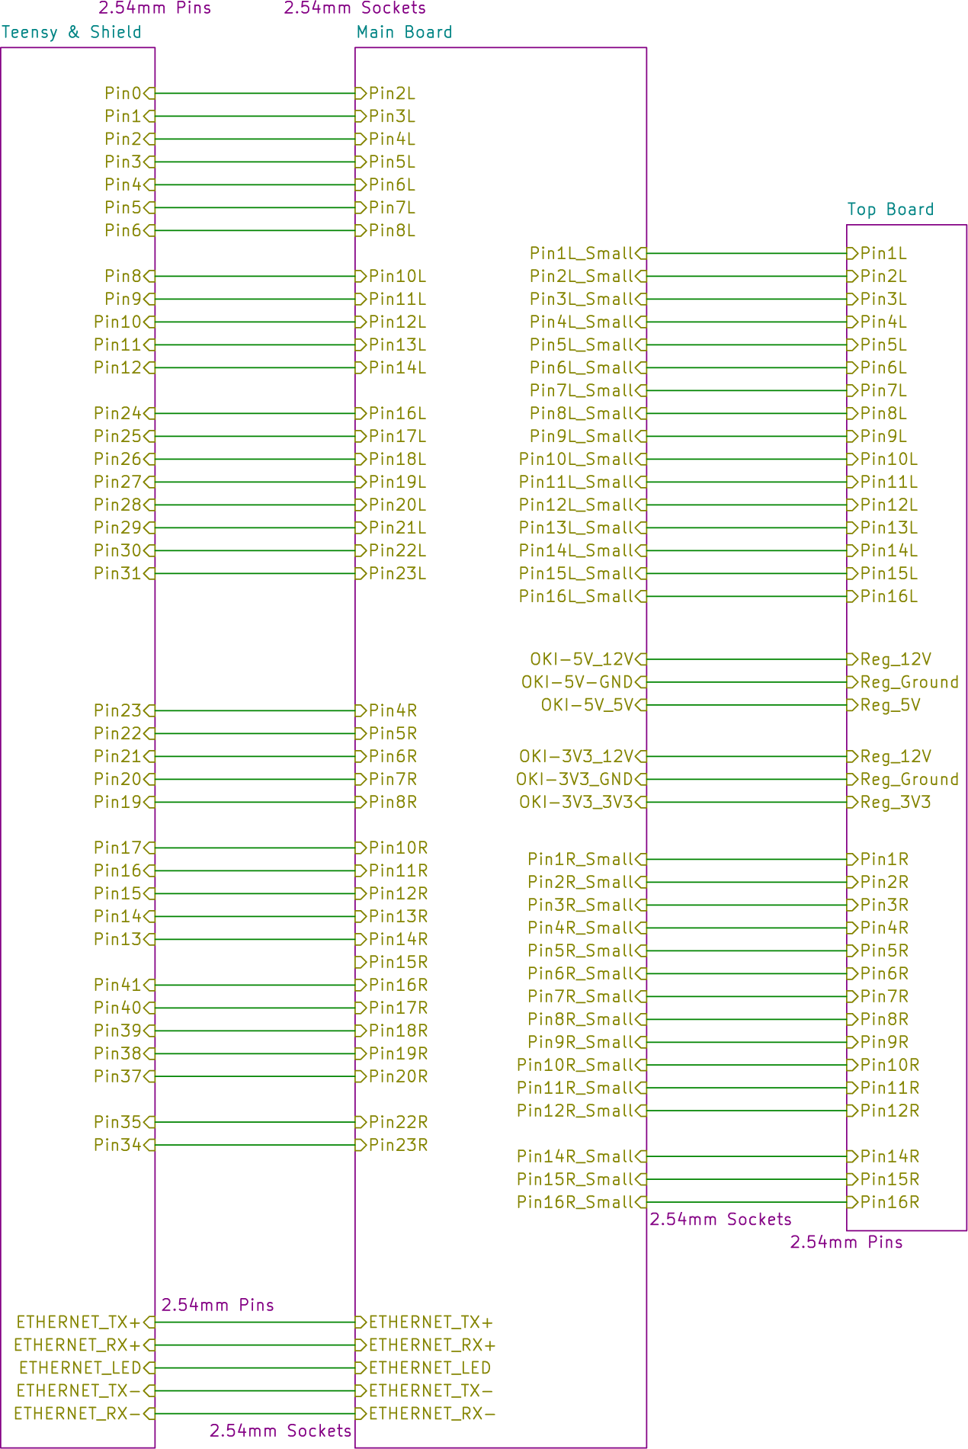
System Overview
3 Modules
Teensy Adapter/Shield
Accesses Teensy pins GPIO pins & Ethernet pins
Main Board
Contains Ethernet Jack & OKI Voltage Regulators, along with PowerPole connectors
Top Board
Holds both accelerometers & GPS connection

Slide 6
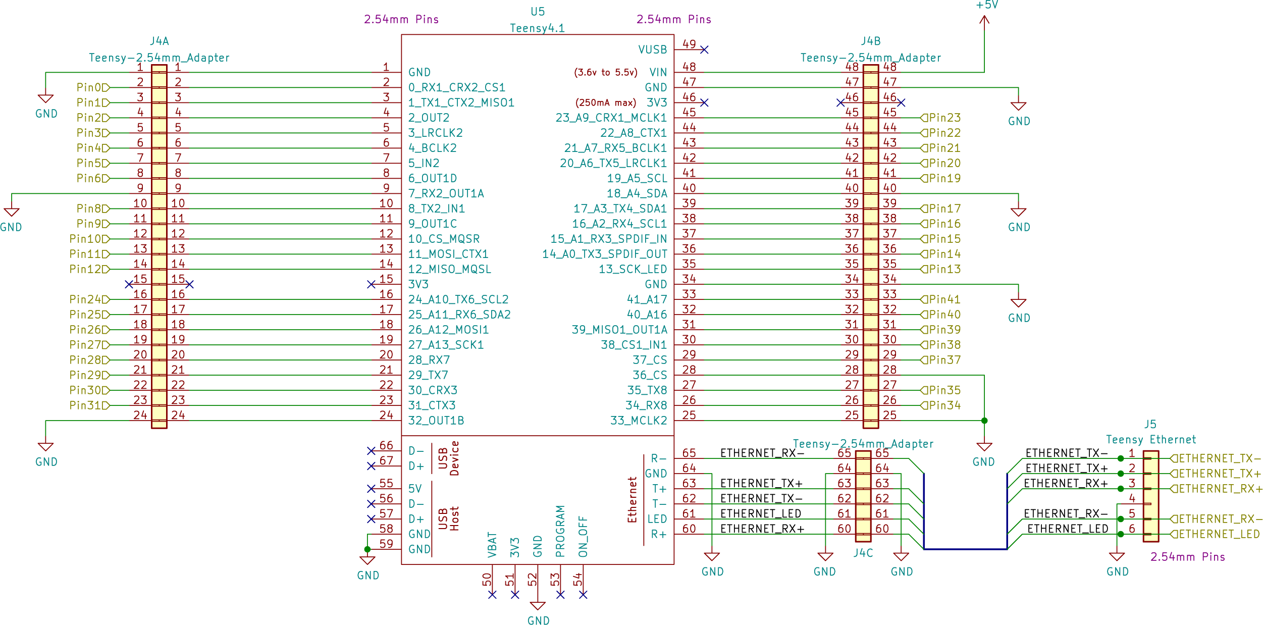
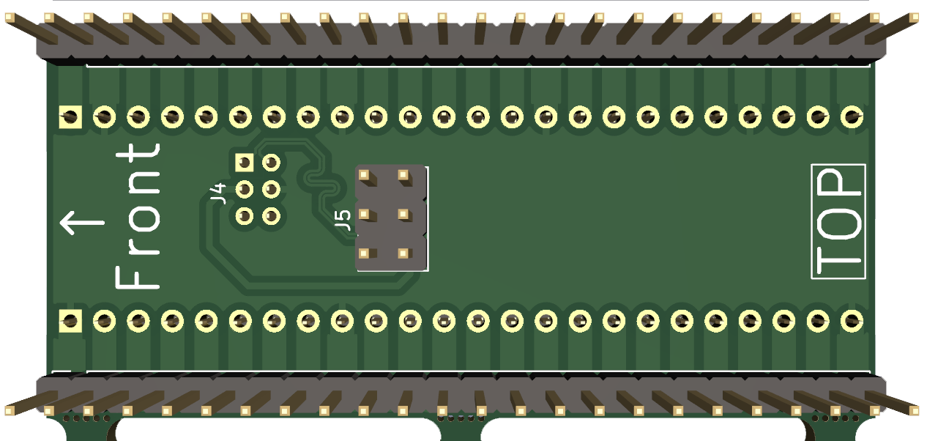
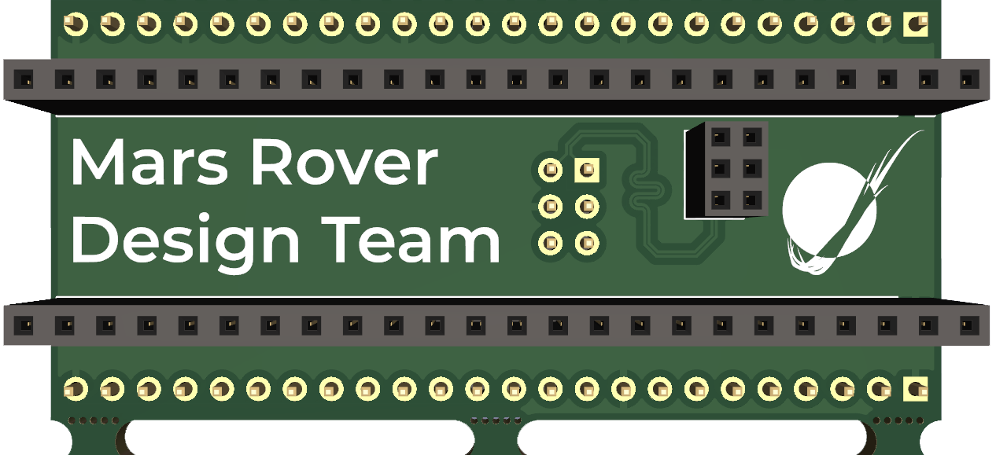
Teensy Adapter
Teensy GPIO
2.54mm Pins on Teensy4.1GPIO,
2.00mm Pins on Teensy4.1 Ethernet
Board Connectors
2.54mm Sockets for Teensy GPIO
2.00mm Sockets Teensy Ethernet
2.54mm Pins for mounting below Main Board

Slide 7
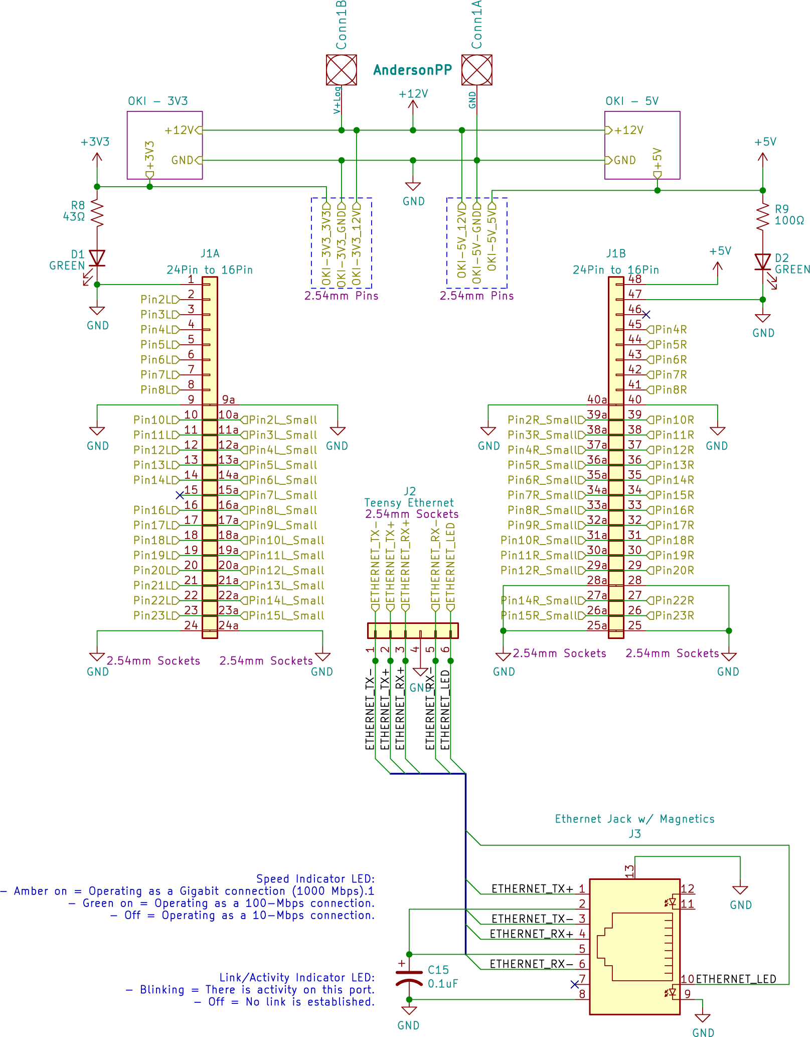
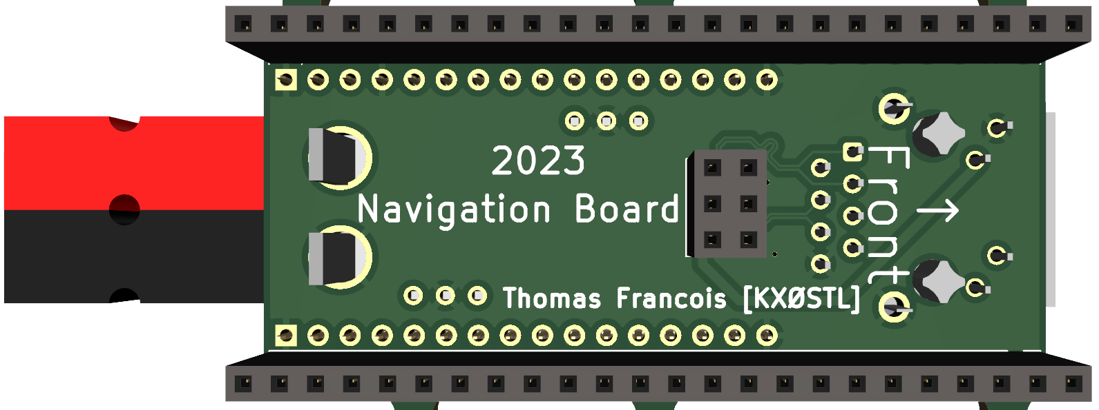
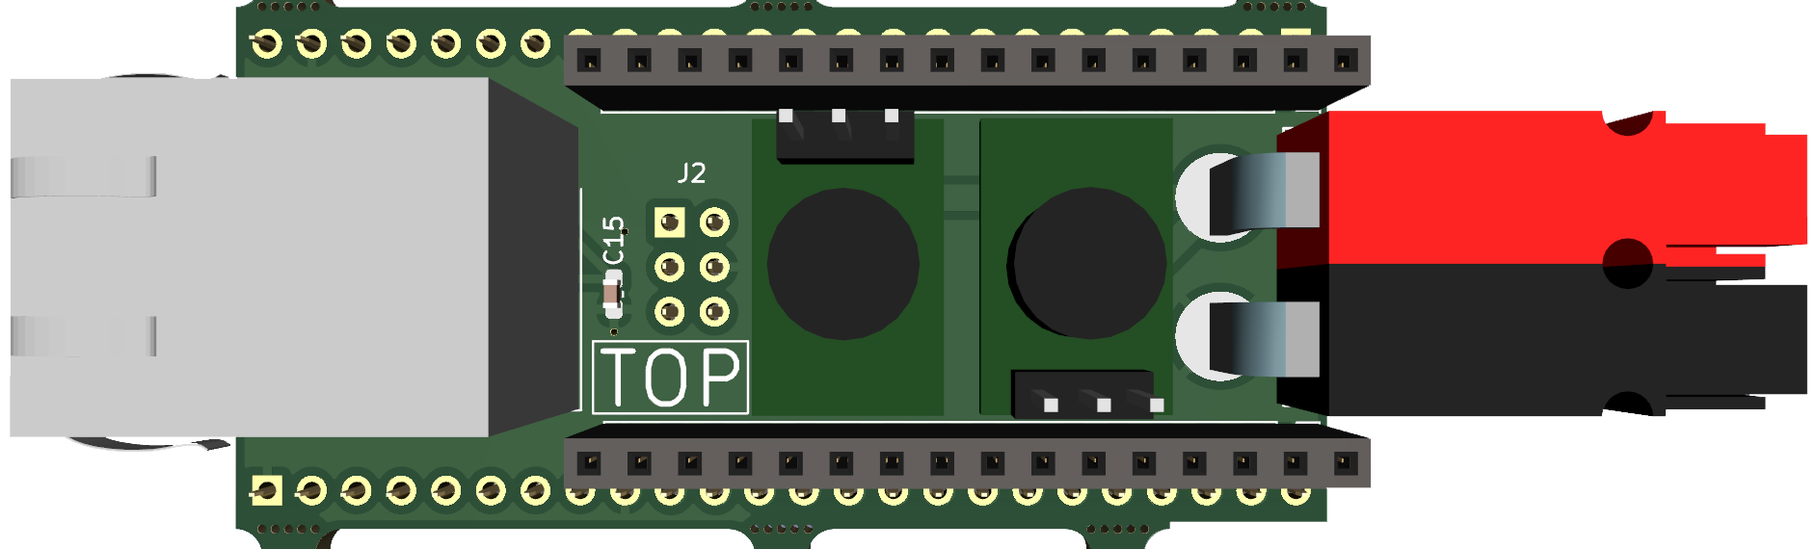
Main Board
Interfaces Ethernet to Teensy
PowerPole connectors to Voltage Regulators
5V and 3V3 OKI Voltage Regulators
Mount onto Main Board, Top Board lowered onto these pins
Board Connections:
2.54mm Sockets to Teensy Adapter
2.54mm Sockets to Top Board

Slide 8
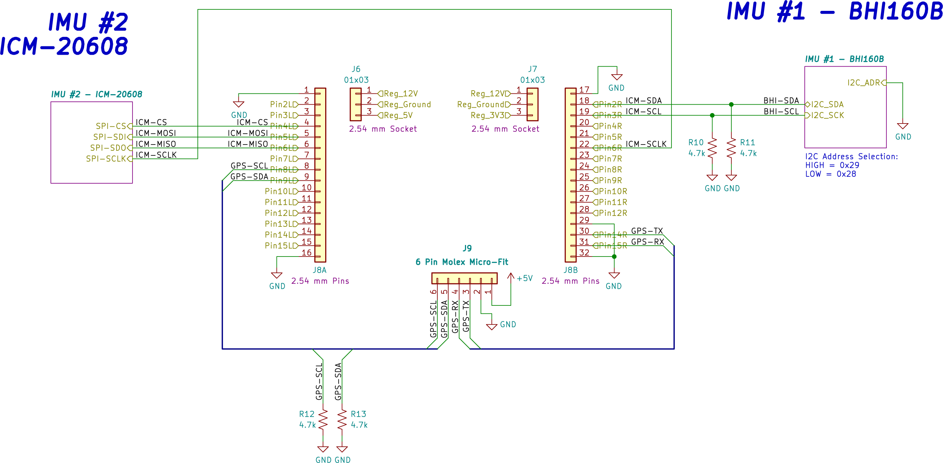
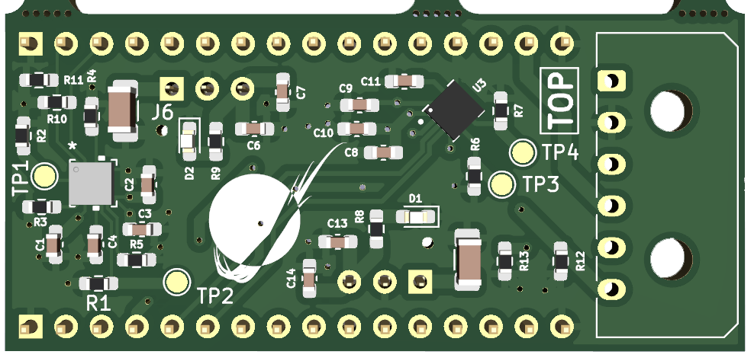
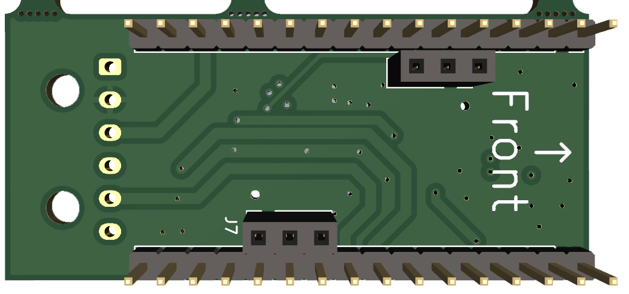
Top Board
Holds Accelerometers
ICM-20608 and BHI160B
GPS Connector
Molex Micro-Fit
Power comes directly from Voltage Regulators
Data routes back to Teensy

Slide 9
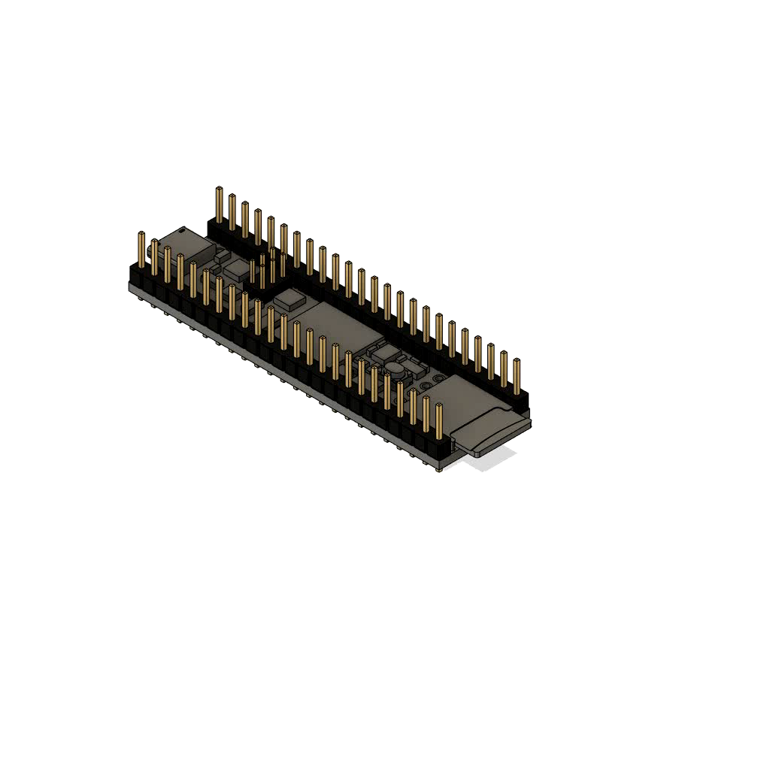
BOM: Same As Before, 2 new parts, & headers
New Additions:
1 Teensy 4.1
1 RJ45 (Teensy Recommends Cetus J1B1211)
2.54mm Headers
4x) 1 by 24 Sockets
4x) 1 by 24 Pins
2x) 1 by 3 Sockets
2x) 1 by 16 Sockets
2x) 1 by 16 Pins
1x) 2 by 3 Pins
1x) 2 by 3 Sockets
2.00mm Headers
1x) 2 by 3 2.00mm Pins
1x) 2 by3 2.00mm Sockets

Slide 10
Still To Do
Ethernet Header between Teensy and Adapter Board are misaligned.
Need to decide upon mounting style.
Alternate Layouts:
Teensy between Teensy Adapter and Main Board, instead of on bottom
Items on Top Board moved onto Adapter Board

